Slide 1
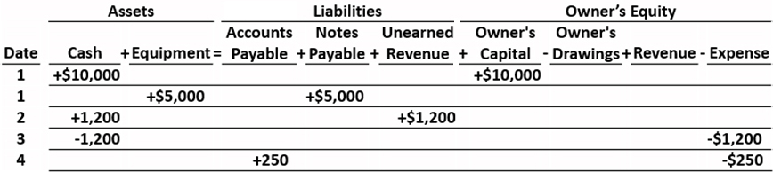
1. Analyze Business Transactions
Partial Schedule
L O 3

Slide 2
2. Journalize the Transactions
blank | General Journal | blank | blank | Page J1
Date | Explanation | Ref. | Debit | Credit
2020 Oct. 1 | Cash | 101 | 10,000 | blank
 | Owners’ Capital | 301 | blank | 10,000
1 | Equipment | 157 | 5,000 | blank
 | Notes Payable | 200 | blank | 5,000
2 | Cash | 101 | 1,200 | blank
 | Unearned Revenue | 209 | blank | 1,200
3 | Rent Expense | 729 | 900 | blank
 | Cash | 101 | blank | 900
L O 3

Slide 3
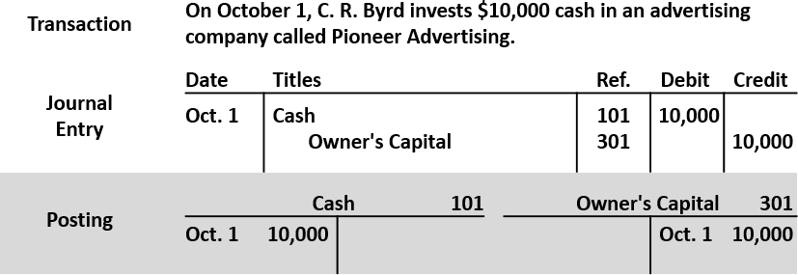
3. Post to the Ledger Accounts
L O 3

Slide 4
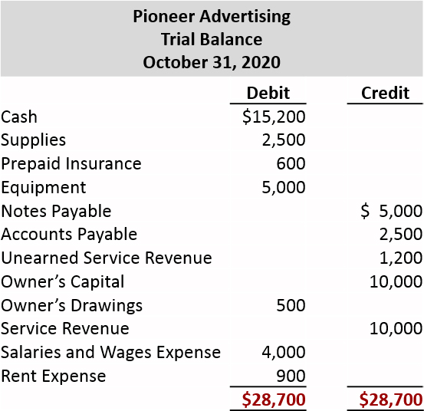
4. Prepare a Trial Balance
L O 3

Slide 5
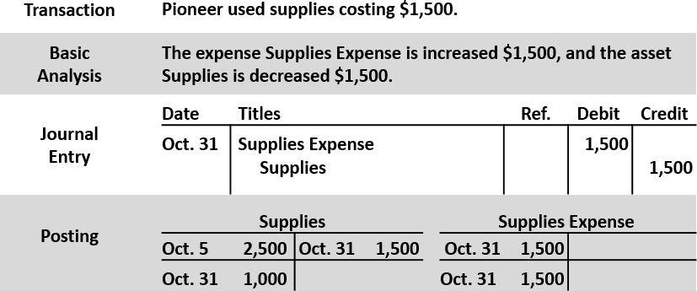
5. Journalize and Post Adjusting Entries
L O 3

Slide 6
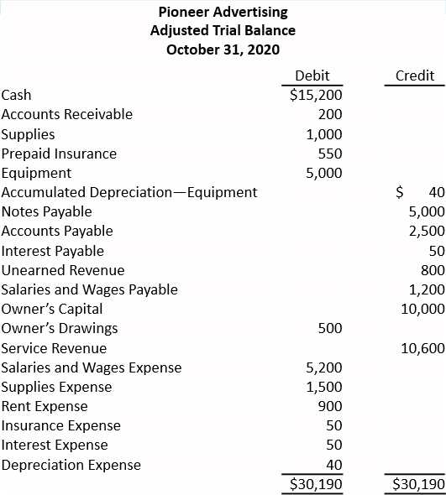
6. Prepare an Adjusted Trail Balance
L O 3

Slide 7
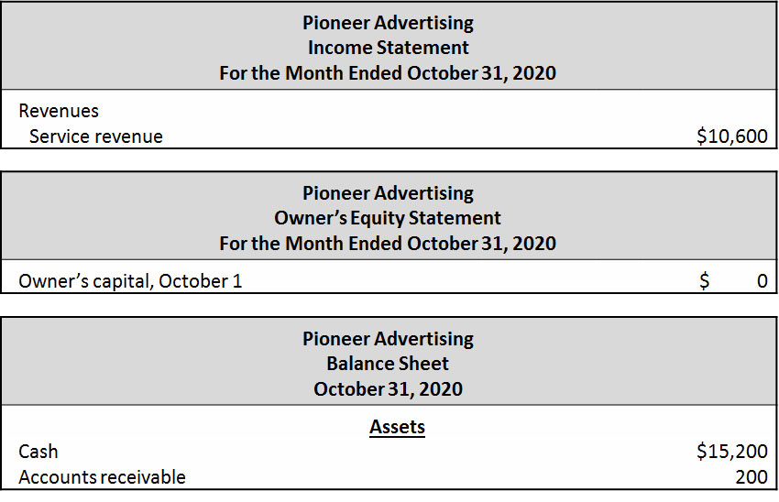
7. Prepare Financial Statements
Partial Statements
L O 3

Slide 8
8. Journalize and Post Closing Entries
Partial Schedule
blank | General Journal | blank | blank | Page J3
Date | Account Titles and Explanations | Ref. | Debit | Credit
2020 Oct. 31 | Service Revenue | 400 | 10,600 | blank
Blank | Income Summary | 350 | blank | 10,600
Blank | (To close revenue account) | blank | blank | blank
31 | Income Summary | 350 | 7,740 | Blank
Blank | Supplies Expense | 631 | Blank | 1,500
Blank | Depreciation Expense | 711 | Blank | 40
Blank | Insurance Expense | 722 | Blank | 50
Blank | Salaries and Wages Expense | 726 | Blank | 5,200
Blank | Rent Expense | 729 | Blank | 900
Blank | Interest Expense | 729 | blank | 50
blank | (To close expense accounts) | blank | blank | blank
L O 3

Slide 9
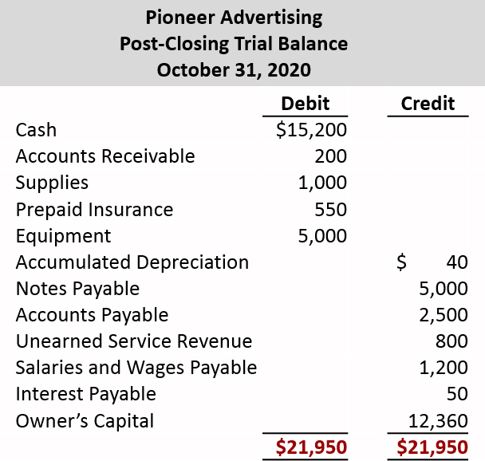
9. Prepare a Post-Closing Trial Balance
L O 3

Slide 10
Correcting Entries—An Avoidable Step (1 of 3)
Unnecessary if accounting records are free of errors
Made whenever an error is discovered
Must be posted before closing entries
Instead of preparing a correcting entry, it is possible to reverse the incorrect entry and then prepare the correct entry.
L O 3

Slide 11
Correcting Entries—An Avoidable Step (2 of 3)
Case 1: On May 10, Mercato Co. journalized and posted a $50 cash collection on account from a customer as a debit to Cash $50 and a credit to Service Revenue $50. The company discovered the error on May 20, when the customer paid the remaining balance in full.
Incorrect entry
Cash 50
Service Revenue 50
Correct entry
Cash 50
Accounts Receivable 50
Correcting entry
Service Revenue 50
Accounts Receivable 50
L O 3

Slide 12
Correcting Entries—An Avoidable Step (3 of 3)
Case 2: On May 10, 18, Mercato purchased on account equipment costing $450. The transaction was journalized and posted as a debit to Equipment $45 and a credit to Accounts Payable $45. The error was discovered on June 3, when Mercato received the monthly statement for May from the creditor.
Incorrect entry
Equipment 45
Accounts Payable 45
Correct entry
Equipment 450
Accounts Payable 450
Correcting entry
Equipment ($450 - $45) 405
Accounts Payable 405
L O 3

Slide 13
Do It! 3|Correcting Entries (1 of 3)
Sanchez Company discovered the following errors made in January 2020.
A payment of Salaries and Wages Expense of $600 was debited to Supplies and credited to Cash, both for $600.
A collection of $3,000 from a client on account was debited to Cash $200 and credited to Service Revenue $200.
The purchase of supplies on account for $860 was debited to Supplies $680 and credited to Accounts Payable $680.
Correct the errors without reversing the incorrect entry.
L O 3

Slide 14
Do It! 3|Correcting Entries (2 of 3)
A payment of Salaries and Wages Expense of $600 was debited to Supplies and credited to Cash, both for $600.
Salaries and Wages Expense 600
Supplies 600
A collection of $3,000 from a client on account was debited to Cash $200 and credited to Service Revenue $200.
Service Revenue 200
Cash ($3,000 - $200) 2,800
Accounts Receivable 3,000
L O 3

Slide 15
Do It! 3|Correcting Entries (3 of 3)
The purchase of supplies on account for $860 was debited to Supplies $680 and credited to Accounts Payable $680.
Supplies ($860 − $680) 180
Accounts Payable 180
L O 3

Slide 16
Classified Balance Sheet
LEARNING OBJECTIVE 4
Identify the sections of a classified balance sheet.
Presents a snapshot at a point in time
To improve understanding, companies group similar assets and similar liabilities together
Assets | Liabilities and Owner’s Equity
Current assets | Current liabilities
Long-term investments | Long-term liabilities
Property, plant, and equipment | Owner’s (Stockholders’) equity
Intangible assets | blank
L O 4

Slide 17
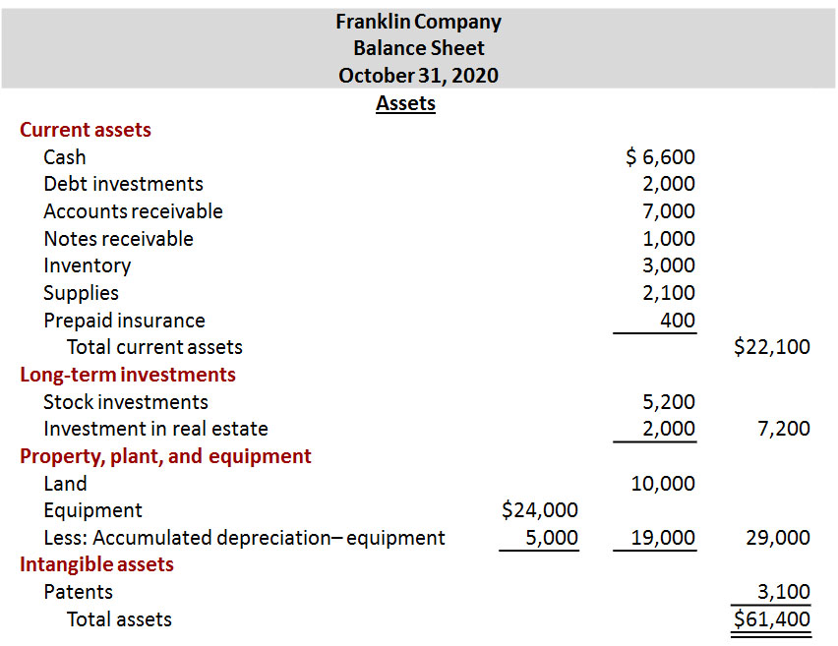
Classified Balance Sheet (1 of 2)
L O 4

Slide 18
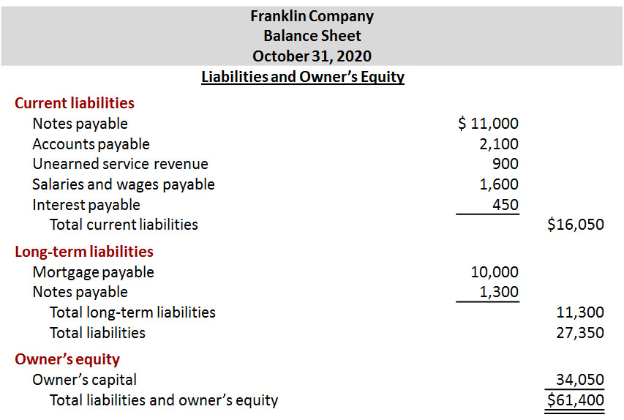
Classified Balance Sheet (2 of 2)
L O 4

Slide 19
Current Assets (1 of 4)
Assets that a company expects to convert to cash or use up within one year or the operating cycle, whichever is longer.
Operating cycle is the average time that it takes to
purchase inventory,
sell it on account, and
collect cash from customers.
L O 4

Slide 20
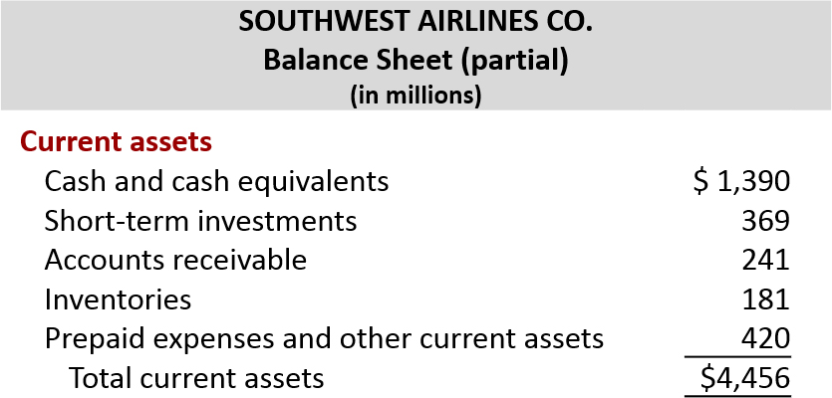
Current Assets (2 of 4)
Accounts usually listed in order liquidity.
L O 4

Slide 21
Current Assets (3 of 4)
The correct order of presentation in a classified balance sheet for the following current assets is:
a. accounts receivable, cash, prepaid insurance, inventory.
b. cash, inventory, accounts receivable, prepaid insurance.
c. cash, accounts receivable, inventory, prepaid insurance.
d. inventory, cash, accounts receivable, prepaid insurance.
L O 4

Slide 22
Current Assets (4 of 4)
The correct order of presentation in a classified balance sheet for the following current assets is:
a. accounts receivable, cash, prepaid insurance, inventory.
b. cash, inventory, accounts receivable, prepaid insurance.
c. Answer: cash, accounts receivable, inventory, prepaid insurance.
d. inventory, cash, accounts receivable, prepaid insurance.
L O 4

Slide 23
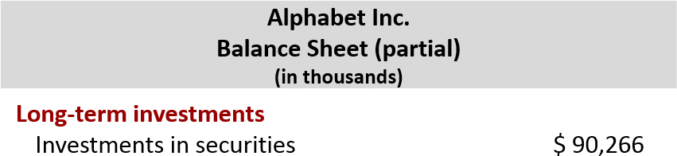
Long-Term Investments
Investments in stocks and bonds of other companies
Investments in long-term assets such as land or buildings that are not currently being used in operating activities
Long-term notes receivable
L O 4

Slide 24
Property, Plant, and Equipment (1 of 2)
Long useful lives
Currently used in operations
Depreciation - allocating the cost of assets to a number of years
Accumulated depreciation - total amount of depreciation expensed thus far in the asset’s life
Sometimes called fixed assets or plant assets
L O 4

Slide 25
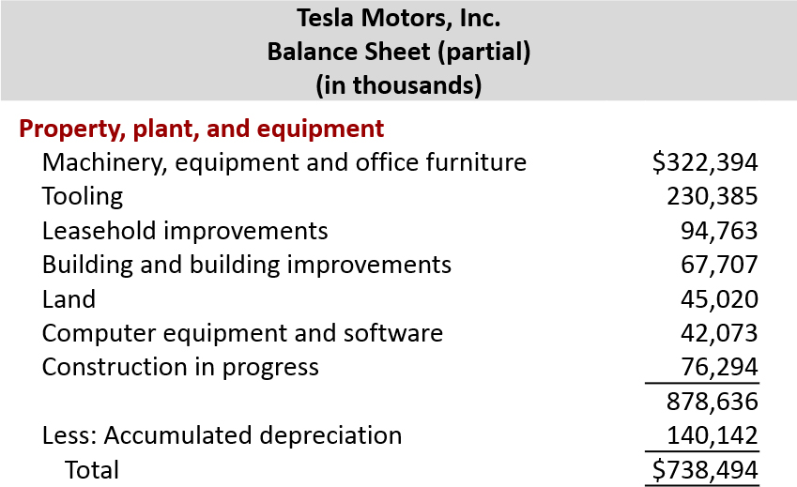
Property, Plant, and Equipment (2 of 2)
L O 4

Slide 26
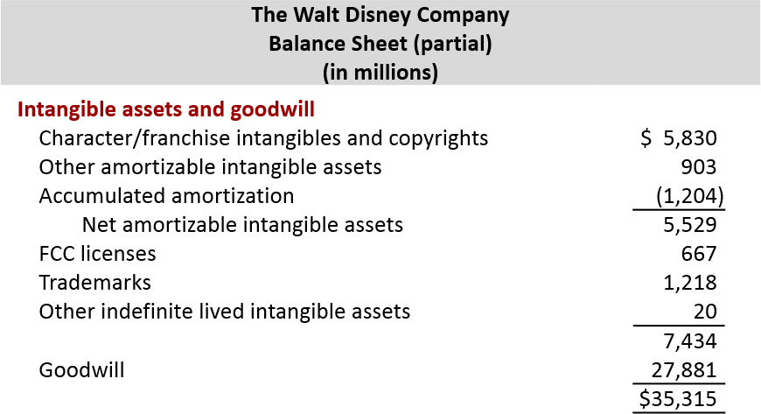
Intangible Assets
Long-lived assets that do not have physical substance
L O 4

Slide 27
Classified Balance Sheet (1 of 4)
Patents and copyrights are
a. Current assets.
b. Intangible assets.
c. Long-term investments.
d. Property, plant, and equipment.
L O 4

Slide 28
Classified Balance Sheet (2 of 4)
Patents and copyrights are
a. Current assets.
b. Answer: Intangible assets.
c. Long-term investments.
d. Property, plant, and equipment.
L O 4

Slide 29
Current Liabilities (1 of 2)
Obligations company is to pay within coming year or its operating cycle, whichever is longer
Usually list notes payable first, followed by accounts payable. Other items follow in order of magnitude
Common examples are accounts payable, salaries and wages payable, notes payable, interest payable, income taxes payable current maturities of long-term obligations
Liquidity - ability to pay obligations expected to be due within the next year
L O 4

Slide 30
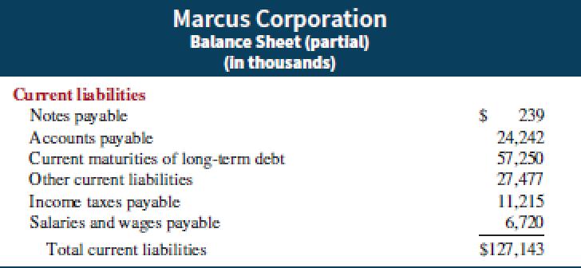
Current Liabilities (2 of 2)
L O 4

Slide 31
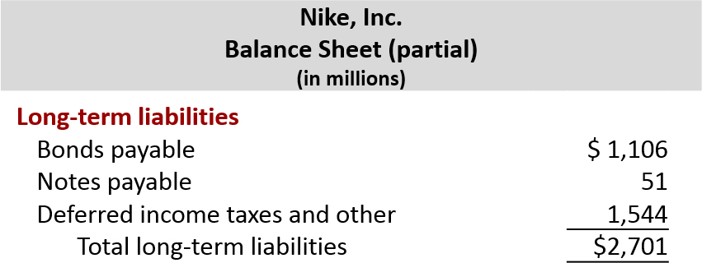
Long-Term Liabilities
Obligations a company expects to pay after one year.
L O 4

Slide 32
Classified Balance Sheet (3 of 4)
Which of the following is not a long-term liability?
a. Bonds payable
b. Current maturities of long-term obligations
c. Long-term notes payable
d. Mortgages payable
L O 4

Slide 33
Classified Balance Sheet (4 of 4)
Which of the following is not a long-term liability?
a. Bonds payable
b. Answer: Current maturities of long-term obligations
c. Long-term notes payable
d. Mortgages payable
L O 4

Slide 34
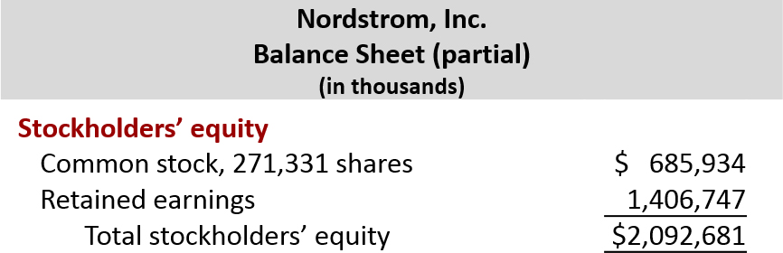
Owner’s Equity
Proprietorship - one capital account
Partnership - capital account for each partner
Corporation - Common Stock and Retained Earnings
L O 4

Slide 35
Do It! 4 | Balance Sheet Classifications (1 of 2)
Match each of the following to its proper balance sheet classification, shown below. If the item would not appear on a balance sheet, use “N A.”
[blank] Salaries and wages payable
[blank] Service revenue
[blank] Interest payable
[blank] Goodwill
[blank] Debt investments (short-term)
[blank] Mortgage payable (due in 3 years)
[blank] Stock investments (long-term)
[blank] Equipment
[blank] Accumulated depreciation
[blank] Depreciation expense
[blank] Owner’s capital
[blank] Unearned service revenue
Current assets (C A)
Long-term investments (L T I)
Property, plant, and equipment (P P E)
Intangible assets (I A)
Current liabilities (C L)
Long-term liabilities (L T L)
Owner’s equity (O E)
L O 4

Slide 36
Do It! 4 | Balance Sheet Classifications (2 of 2)
Match each of the following to its proper balance sheet classification, shown below. If the item would not appear on a balance sheet, use “N A.”
C L Salaries and wages payable
N A Service revenue
C L Interest payable
I A Goodwill
C A Debt investments (short-term)
L T L Mortgage payable (due in 3 years)
L T I Stock investments (long-term)
P P E Equipment
P P E Accumulated depreciation
N A Depreciation expense
O E Owner’s capital
C L Unearned service revenue
Current assets (C A)
Long-term investments (L T I)
Property, plant, and equipment (P P E)
Intangible assets (I A)
Current liabilities (C L)
Long-term liabilities (L T L)
Owner’s equity (O E)
L O 4

Slide 37
Appendix 4A Reversing Entries
It is often helpful to reverse some adjusting entries before recording regular transactions of the next period.
Companies make a reversing entry at beginning of next accounting period.
Each reversing entry is exact opposite of adjusting entry made in previous period.
Use of reversing entries does not change amounts reported in the financial statements.
L O 5

Slide 38
Reversing Entries Example (1 of 3)
We use the salaries expense transactions for Pioneer Advertising as illustrated in Chapters 2, 3, and 4.
October 26 (initial salary entry): Pioneer pays $4,000 of salaries and wages earned between October 15 and October 26.
October 31 (adjusting entry): Salaries and wages earned between October 29 and October 31 are $1,200. The company will pay these in the November 9 payroll.
November 9 (subsequent salary entry): Salaries and wages paid are $4,000. Of this amount, $1,200 applied to accrued salaries and wages payable and $2,800 was earned between November 1 and November 9.
L O 5

Slide 39
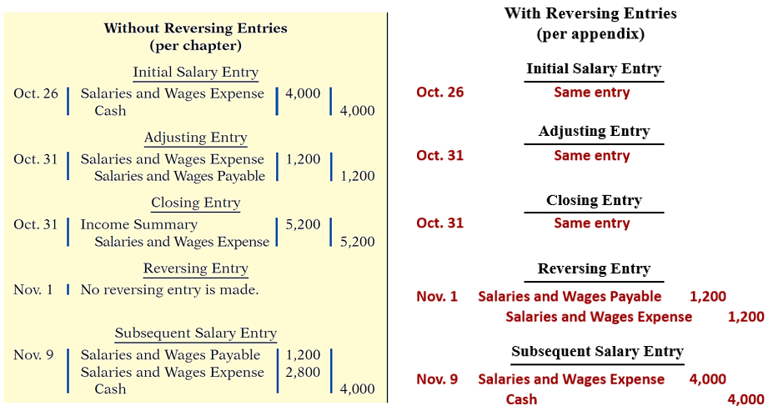
Reversing Entries Example (2 of 3)
L O 5

Slide 40
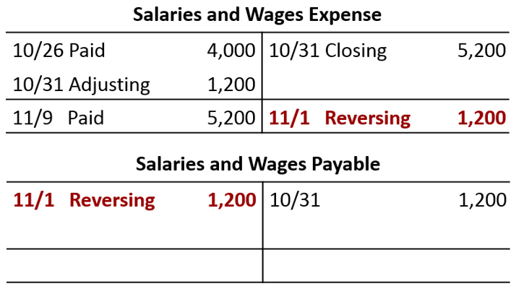
Reversing Entries Example (3 of 3)
L O 5

Slide 41
A Look at I F R S (1 of 4)
Key Points
Similarities
The procedures of the closing process are applicable to all companies, whether they are using I F R S or G A A P.
I F R S generally requires a classified statement of financial position similar to the classified balance sheet under G A A P.
I F R S follows the same guidelines as G A A P for distinguishing between current and non-current assets and liabilities.
L O 6

Slide 42
A Look at I F R S (2 of 4)
Key Points
Differences
IFRS recommends but does not require the use of the title “statement of financial position” rather than balance sheet.
The format of statement of financial position information is often presented differently under IFRS. Although no specific format is required, many companies that follow IFRS present statement of financial position information in this order:
Non-current assets
Current assets
Equity
Non-current liabilities
Current liabilities
L O 6

Slide 43
A Look at I F R S (3 of 4)
Key Points
Differences
Under I F R S, current assets are usually listed in the reverse order of liquidity. For example, under G A A P cash is listed first, but under I F R S it is listed last.
I F R S has many differences in terminology from what are shown in your textbook.
Both G A A P and I F R S are increasing the use of fair value to report assets. However, at this point I F R S has adopted it more broadly. As examples, under I F R S, companies can apply fair value to property, plant, and equipment, and in some cases intangible assets.
L O 6

Slide 44
A Look at I F R S (4 of 4)
Looking to the Future
The I A S B and the F A S B are working on a project to converge their standards related to financial statement presentation. A key feature of the proposed framework is that each of the statements will be organized in the same format, to separate an entity’s financing activities from its operating and investing activities and, further, to separate financing activities into transactions with owners and creditors. Thus, the same classifications used in the statement of financial position would also be used in the income statement and the statement of cash flows. The project has three phases. You can follow the joint financial presentation project at the F A S B website.
L O 6

Slide 45
Copyright
Copyright © 2018 John Wiley & Sons, Inc.
All rights reserved. Reproduction or translation of this work beyond that permitted in Section 117 of the 1976 United States Act without the express written permission of the copyright owner is unlawful. Request for further information should be addressed to the Permissions Department, John Wiley & Sons, Inc. The purchaser may make back-up copies for his/her own use only and not for distribution or resale. The Publisher assumes no responsibility for errors, omissions, or damages, caused by the use of these programs or from the use of the information contained herein.

